Slide 1
Request - Response
BEST PRACTICES

Slide 2
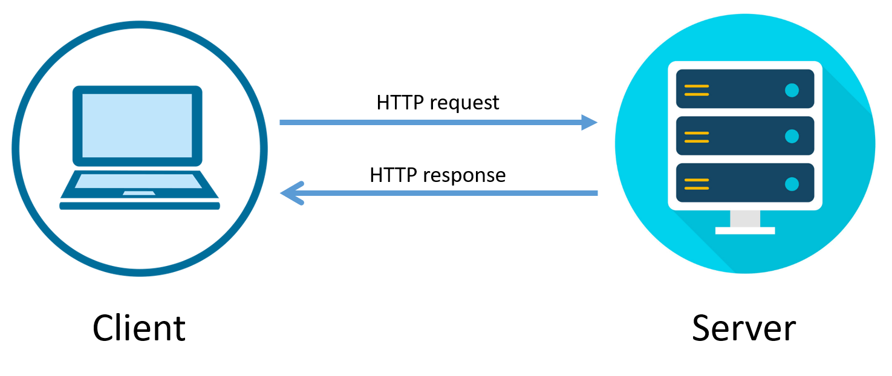
HTTP/HTTPS Request Response Communication
In request/response communication mode.
One software module sends a request to a second software module and waits for a response.
The First software module performs the role of the client.
The second, the role of the server,
This is called client/server interaction.

Slide 3

HTTP Client - Browser Level
Browser is the primary HTTP Client responsible for load the web application.

Slide 4
HTTP Client - Application Level
HTTP Client is an application library used in client side application to generate request and receive response.
HTTP Client’s libraries varies from platform to platform
HTTP Client Library | Platform | Language
Volly | Native Android | Java
Retrofit | Native Android | Java
Rest Sharp | ASP.NET | C#
Axios | Mobile/Web/Desktop | JavaScript
cURL | Web | PHP
Alamofire | Native IOS | Swift

Slide 5
POSTMAN Http Client
Postman is an HTTP Client application, used to test request-response communication. Postman is widely used for API testing and generating documentation.
Quickly and easily send REST, SOAP, and GraphQL requests directly within Postman.
Generate and publish beautiful, machine-readable API documentation.
Checking performance and response times at scheduled intervals.
Communicate the expected behavior of an API by simulating endpoints and their responses

Slide 6
HTTP Request
HTTP Request is the first step to initiate web request/response communication. Every request is a combination of request header, body and request URL.
Http Request Segments:
Request Area | Standard Data Type
Body | Simple String, JSON, Download, Redirect, XML
Header | Key Pair Value
URL Parameter | String

Slide 7
HTTP Request Methods
Method Name | Responsibilities
GET() | The GET method is used to retrieve information from the given server using a given URI. Requests using GET should only retrieve data and should have no other effect on the data.
Head() | Same as GET, but transfers the status line and header section only.
POST() | A POST request is used to send data to the server, for example, customer information, file upload, etc. using HTML forms.
PUT() | Replaces all current representations of the target resource with the uploaded content.
DELETE() | Removes all current representations of the target resource given by a URI.

Slide 8
Request Compare GET vs. POST:
Key Points | GET | POST
BACK button/Reload | Harmless | Data will be re-submitted (the browser should alert the user that the data are about to be re-submitted)
Bookmarked | Can be bookmarked | Cannot be bookmarked
Cached | Can be | Never
Encoding type | application/x-www-form-urlencoded | application/x-www-form-urlencoded or multipart/form-data. Use multipart encoding for binary data
History | Parameters remain in browser history | Parameters are not saved in browser history
Restrictions on data length | Yes, when sending data, the GET method adds the data to the URL; and the length of a URL is limited (maximum URL length is 2048 characters) | No restrictions
Restrictions on data type | Only ASCII characters allowed | No restrictions. Binary data is also allowed
Security | GET is less secure compared to POST because data sent is part of the URL. Never use GET when sending passwords or other sensitive information! | POST is a little safer than GET because the parameters are not stored in browser history or in web server logs
Visibility | Data is visible to everyone in the URL | Data is not displayed in the URL

Slide 9
HTTP Request Throttling
Throttle Request refers to a process in which a user is allowed to hit the application maximum time in per second or per minute. Throttling is also known as request rate limiting.
Essential component of Internet security, as DoS attacks can tank a server with unlimited requests.
Rate limiting also helps make your API scalable by avoid unexpected spikes in traffic, causing severe lag time.

Slide 10
HTTP Response
Http response is the final step of request-response communication. Every response is a combination of response header, body an d cookies.
Http Response Segments:
Response Area | Standard Data Type
Body | Simple String, JSON, Download, Redirect, XML
Header | Key Pair Value
Cookies | Key Pair Value

Slide 11
HTTP Response Status Messages
Code | Meaning | Description
200 | OK | The request is OK (this is the standard response for successful HTTP requests)
201 | Created | The request has been fulfilled, and a new resource is created
202 | Accepted | The request has been accepted for processing, but the processing has not been completed
203 | Non-Authoritative Information | The request has been successfully processed, but is returning information that may be from another source
204 | No Content | The request has been successfully processed, but is not returning any content
205 | Reset Content | The request has been successfully processed, but is not returning any content, and requires that the requester reset the document view
206 | Partial Content | The server is delivering only part of the resource due to a range header sent by the client
400 | Bad Request | The request cannot be fulfilled due to bad syntax
401 | Unauthorized | The request was a legal request, but the server is refusing to respond to it.
403 | Forbidden | The request was a legal request, but the server is refusing to respond to it
404 | Not Found | The requested page could not be found but may be available again in the future

Slide 12
HTTP Response Status Messages
Code | Meaning | Description
405 | Method Not Allowed | A request was made of a page using a request method not supported by that page
408 | Request Timeout | Request Timeout
500 | Internal Server Error | A generic error message, given when no more specific message is suitable
502 | Bad Gateway | The server was acting as a gateway or proxy and received an invalid response from the upstream server
503 | Service Unavailable | The server is currently unavailable (overloaded or down)

